Slide 1


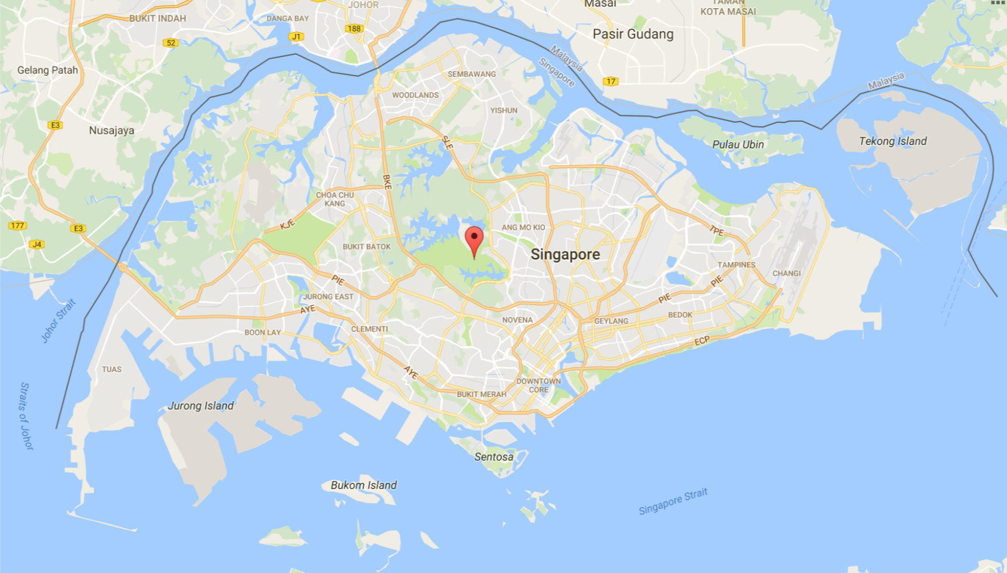








Login
REPORT ACCIDENT
Filter
Accident
Speed Camera
Traffic Camera
Reset

Slide 2



Login
REPORT ACCIDENT
Location
Current Location
Cause of Accident
Unknown
DD/MM/YYYY
03
04
17
Ok
Cancel
Filter
Accident
Speed Camera
Traffic Camera
Reset

Slide 3
Login
REPORT ACCIDENT
Reservoir Park
Ok
Filter
Accident
Speed Camera
Traffic Camera
Reset

Slide 4
Login
REPORT ACCIDENT
Your accident report has been submitted
Thank you for your contribution
Ok
Filter
Accident
Speed Camera
Traffic Camera
Reset

Slide 5



Login
REPORT ACCIDENT
Username
Password
Login
Forgot your password?
Filter
Accident
Speed Camera
Traffic Camera

Slide 6



User: Stella
8
REPORT ACCIDENT
Filter
Accident
Speed Camera
Traffic Camera
Pending Camera
Reset

Slide 7
User: Stella
8
Pending Accident Reports
REPORT ACCIDENT
Existing Accidents
Resolved Accidents
Accident Reports
Filter
Accident
Speed Camera
Traffic Camera
Pending Camera
Reset

Slide 8
Pending Accident Reports
User: Stella
Location: Tampines Ave 12
Cause: Unknown
Date: 4/2/2017
REPORT ACCIDENT
Filter
Accident
Speed Camera
Traffic Camera
Pending Camera
Reset

